Slide 1
ESTABLISHMENT OF ALL INDIA MUSLIM LEAGUE
TEAM MEMBERS:
Eisha 17K-3730
Fatima 17K-3639
Urwa 17K-3880
Tabinda 17K-3909

Slide 2
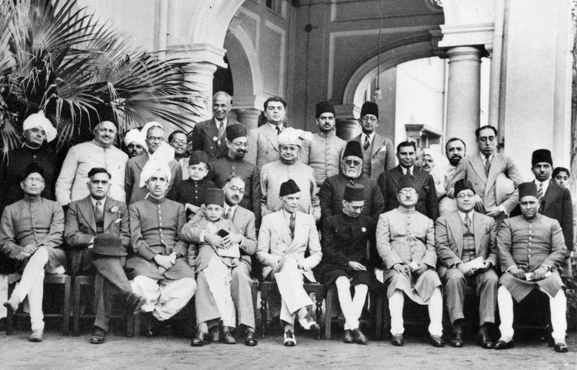

Slide 3
EVENTS LEADING TO THE FORMATION OF MUSLIM LEAGUE:
1. HINDI-URDU CONTROVERSY-NAGARI PRACHINI SABHA'S DEMAND - United Province.
2. PARTITION OF BENGAL[1905].
3. ALIGARH MOVEMENT after Sir Syed Ahmed Khan - Role of Nawab Mohsin-ul-Mulk.
4.MUSLIM DEPUTATION TO LORD MINTO - Demand for assurance of Muslim Employement, Reservation of seats for Muslims, Separate Electorate, recoginising Political Importance of Muslims , Establishment of Muslim University.

Slide 4
5. MORLEY MINTO REFORMS - Acceptance of seperate electorates for Muslims in Election to Imperial Legislative Councils and Provincial Councils.
6.THE SUCCESS OF SIMLA DEPUTATION -Minto offered fullest sympathy to the Muslim demands. The success of Deputation compelled the Muslims to have a separate political association of their own.
7.TO SAVE MUSLIM ENTITY - The belief uttered by Sir Syed Ahmed Khan that the Muslims were somehow a separate entity. The Muslims did not believe that Hindus and Muslims formed one nation. They were different by religion, history, languages and civilization. It became essential for Muslims to establish a political party of their own.

Slide 5
THE REASONS BEHIND THE FORMATION OF ALL INDIA MUSLIM LEAGUE
The three key factors which contributed in keeping the Muslims away from the Congress were:
The advice and prediction of Sir Syed Ahmed Khan that, “Hindus and Muslims are two different nations who have different ideologies”
Hindu protest against the partition of Bengal .
3. Hindu revivalists’ aggression towards the Muslims The Muslims stayed devoted to Sir Syed's recommendation.

Slide 6
FACTORS PROMOTING THE FORMATION OF MUSLIM LEAGUE WERE:
1. British Policy of divide and rule .
2.Economic and educational Backwardness.
3.Religious Tinge of Indian Nationalism.
4. Role of Sir Syed Ahmed Khan.
5. MUHAMMADEN ANGLO-ORIENTAL defense Association.

Slide 7
British Policy of divide and rule:
1. Attitude of the British towards Muslims after the first war of Independence.
2. Change of British Policies after formation of Congress.
3. Divide and Rule Policy.
Economic and Educational Backwardness:
1. Lack of employment opportunity.
2.Affect of British Apathy on Muslim community.

Slide 8
Religious Tinge of Indian Nationalism:
1. TILAK--GANESH/SHIVAJI festival.
2.BIPIN CHANDRA PAL--''LORD KRISHNA is the soul of India''.
3.Expoitation of British in their favour.
4.Muslims choose to remain aloof from National Struggle.
Role of Sir Syed Ahmed Khan:
1. Promoting Western Education among Muslims.
2. Belief in Hindi-Urdu unity.
3. Opressing Congress--change in his view after establishment of Congress.
4. Promoting Loyalty towards British among muslims.

Slide 9
MUHAMMADEN ANGLO-ORIENTAL defense Association Objectives:
1.Protect Muslim rights.
2.Acquaint British Government with Muslims views.
3.Work towards strengthening British rule in India.
4.Create feeling of Loyalty among British.
5.Prevent Muslims from joining National Movement.

Slide 10
ALL INDIA MUSLIM LEAGUE
Establish during early years of 20th century in british india empire.
Formed on 30th December 1906
Conference in Dhaka attend by 3000 delegates
Name of party was “All INDIA MUSLIM LEAGUE” was proposed by “Sir Mian Muhammad Shafi”.
First Honorary president of muslim League “Sir sultan Muhammad Shah”

Slide 11
Head quarter at lucknow
Six vice president a secretary and 2 joint secretaries
These initially appointed for 3 years from different provinces
Principles of league espoused in ” Green Book” written by Maulana Muhammad Ali
Leading role “Aga Khan”
1913 Muhammad Ali Jinnah joined the muslim league.
Until,1939 faculty and students supported Indaian national movement

Slide 12
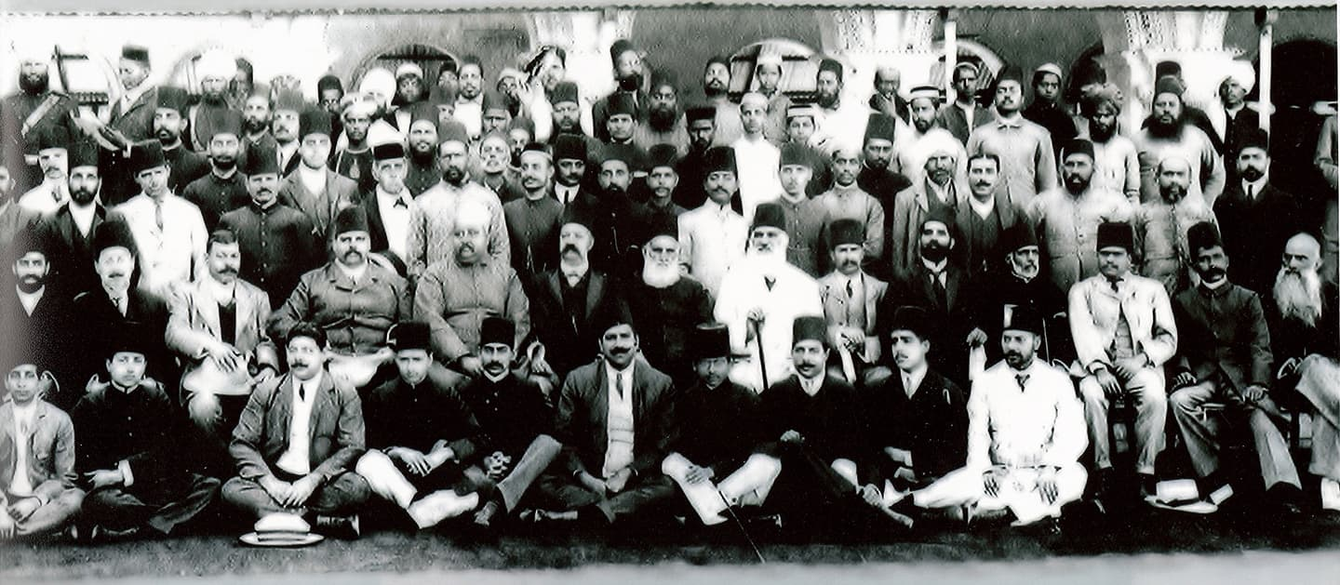

Slide 13
AIMS AND OBJECTIVES OF ALL INDIA MUSLIM LEAGUE
The main objectives of the formation of All India Muslim league was to safeguard interests and rights of Muslims and their political training to equip them with the basic political knowledge so that they can face congress propaganda effectively. The main purpose of Muslim league were as follows:-
To create among Muslims the feelings of loyalty towards British Government and to remove all the misconceptions and suspiciousness.

Slide 14
To safeguard the political rights of the Muslims and to bring them into the notice of the Government.
Third was to prevent among the Muslims, the rise of prejudicial feelings against the other communities of India.
Fourth was to express religious identity.
Fifth was to develop unity among the Muslims.

Slide 15
Summary of the objectives:
From this, we can conclude that the main objectives of the All India Muslim league was to safeguard and protect the interests of the Muslims of the sub-continent and to convey their demands.
To create goodwill and respect for the government amongst the Muslims.
To remove all sorts of misunderstandings about any action or issues of the government.

Slide 16
To provide a platform to the Muslims of the subcontinent for their collective struggle.
To be the national identity for the Muslims and create a sense of unity amongst them.
To regain the lost pride of the Muslims in the society.

Slide 17
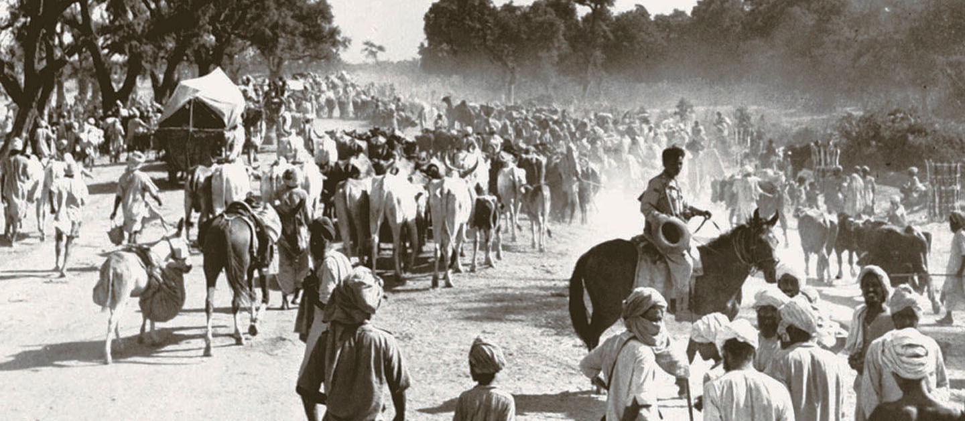
ROLE OF ALL INDIA MUSLIM LEAGUE IN PAKISTAN MOVEMENT AND ESTABLISHMENT OF PAKISTAN

Slide 18
The biggest goal that they achieved was Pakistan.
Educational and economical progress of Muslims.
They became a massive movement of Muslims that gave them courage to fight for their rights.
Muslims got their representatives and a platform to raise themselves as a big nation living in sub continent.
They were able to their objectives .

Slide 19
The spirit of independence was raised among the Muslims.
Muslims regained their identity as a big nation living in sub continent.
Not only men but women and students also took part effectively in Pakistan movement.
People got awareness about the causes and need of the demand for separate homeland.
They expressed their separate religious identity

Slide 20
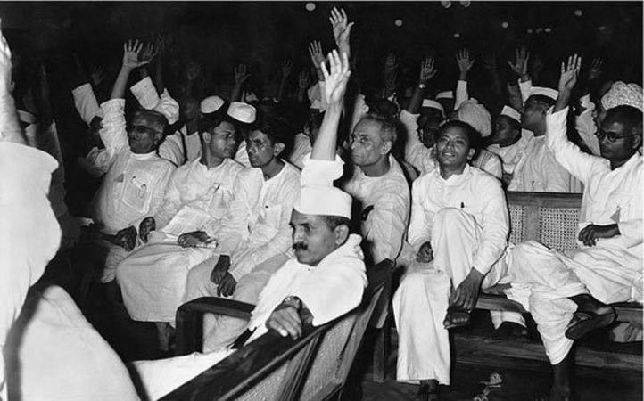

Slide 21


Slide 22
Thank You..!!
Any Questions ?

